Slide 1
BCNF and Temporal Data Modelling

Slide 2
Boyce Codd normal form (BCNF)
Boyce–Codd Normal Form (BCNF) is based on functional dependencies that take into account all candidate keys in a relation
BCNF also has additional constraints compared with the general definition of 3NF
Note: A relation is in BCNF if and only if every determinant is a candidate key

Slide 3
Boyce Codd normal form (BCNF)
Difference between 3NF and BCNF is that for a functional dependency A -> B,
3NF allows this dependency in a relation if B is a primary-key attribute and A is not a candidate key
Whereas, BCNF insists that for this dependency to remain in a relation, A must be a candidate key
Every relation in BCNF is also in 3NF
However, a relation in 3NF is not necessarily in BCNF

Slide 4
Normal Form Hierarchy
1NF
2NF
3NF
BCNF

Slide 5
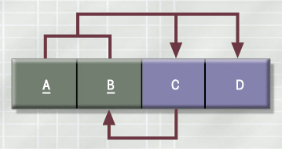
A Table That Is In 3NF But Not In BCNF

Slide 6
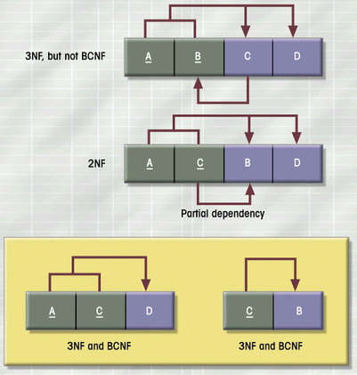
The Decomposition of a Table Structure to Meet BCNF Requirements

Slide 7
BCNF Decomposition Algorithm
The algorithm to be followed for decomposition is,
Determine the functional dependency that violates the BCNF
For every functional dependency X->Y from F which violates, decompose the relation into R-Y and XY (R is a relation)
Repeat until all the relations satisfy BCNF

Slide 8
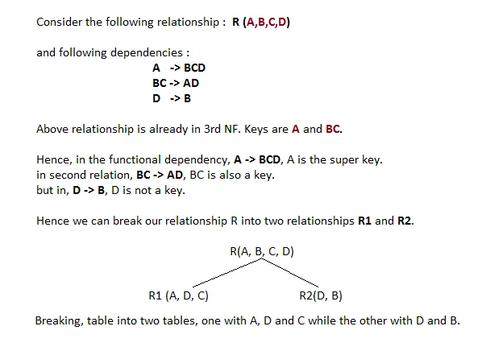
BCNF Example
a) BCNF normalization

Slide 9
Example
R=ABCDE
The functional dependencies are FD = {A -> BC, C -> DE)
Solution:
Candidate keys are {A}
A -> BC since A is a key for R this FD does not violate BCNF
C -> DE, C is not a key of R
We decompose R into (CDE) (ABC)

Slide 10
Temporal Databases
A temporal database stores data relating to time instances. It offers temporal data types and stores information relating to past, present and future time.
Temporal databases could be uni-temporal, bi-temporal or tri-temporal.
More specifically the temporal aspects usually include valid time, transaction time or decision time.
Valid time is the time period during which a fact is true in the real world.
Transaction time is the time at which a fact was recorded in the database.
Decision time is the time at which the decision was made about the fact.

Slide 11
Modeling Temporal Data
Temporal data have an association time interval during which the data are valid
A snapshot is the value of the data at a particular point in time
Several proposals to extend ER model by adding valid time to
attributes, e.g., address of an instructor at different points in time
entities, e.g., time duration when a student entity exists
relationships, e.g., time during which an instructor was associated with a student as an advisor.
But no accepted standard

Slide 12
Modeling Temporal Data
Adding a temporal component results in functional dependencies like
ID → street, city
not to hold, because the address varies over time
A temporal functional dependency X → Y holds on schema R if the functional dependency X → Y holds on all snapshots for all legal instances r(R)

Slide 13
Modeling Temporal Data
In practice, database designers may add start and end time attributes to relations
E.g., course(course_id, course_title) is replaced by
course(course_id, course_title, start, end)
Constraint: no two tuples can have overlapping valid times
Hard to enforce efficiently

